Slide 1
Fairness and Wrap-Up
CS 344 – 2022-04-21

Slide 2
Automating High-Stakes Decisions
What credit score should be required to get a certain loan?
Which defendants should be freed until their trial?
Which candidates should get a certain job?
Which students should get into a university?
Think of some examples of unfair decisions.
How can you tell that the decision is unfair?

Slide 3
Main Point
Every policy is “unfair” by some definition.
Different stakeholders may care about different definitions
Different worldviews underlie different definitions

Slide 4
Recidivism Prediction
Bail is archaic (the rich can go free)! Is there an objective alternative?
Idea: release people unlikely to commit a crime before their trial
Northpointe COMPAS machine learning system
Data: criminal records, demographics
Prediction: will the defendant be arrested again in ≤ 2 years?
What could possibly go wrong?

Slide 5
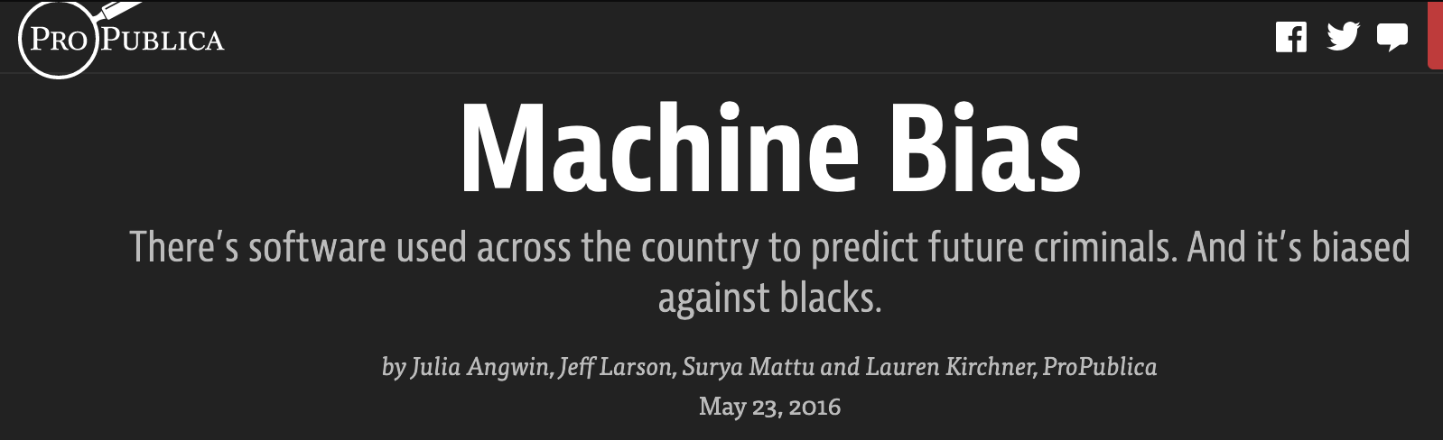
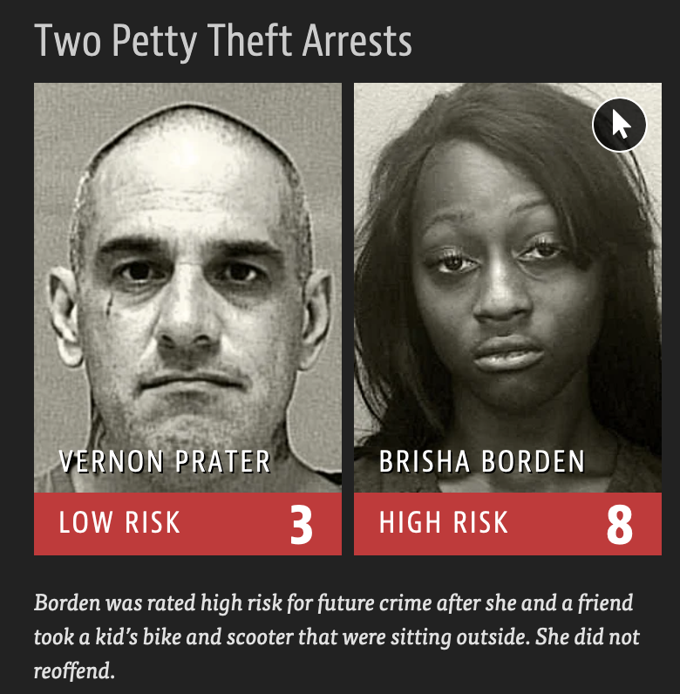
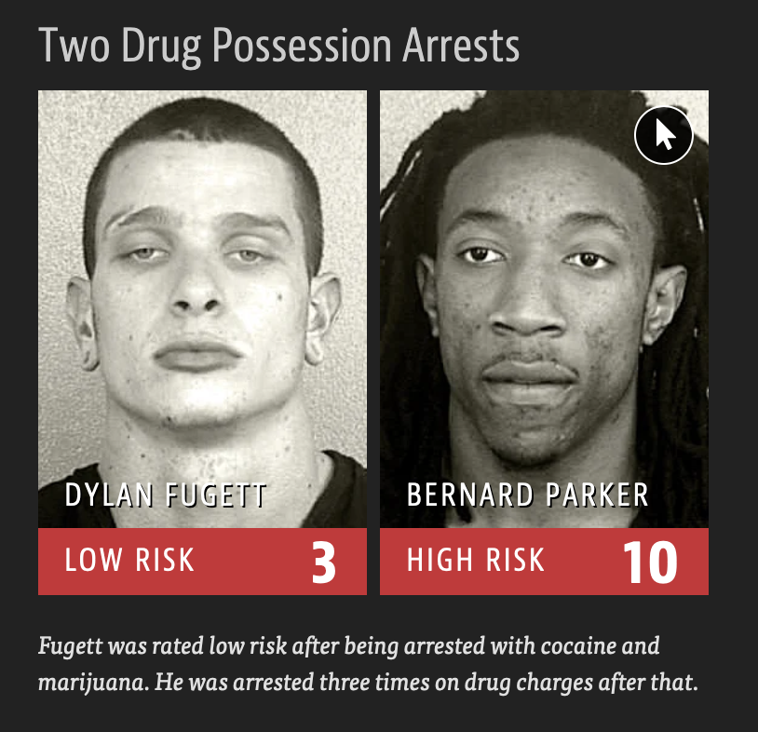

Slide 6
Confusion Matrix
https://en.wikipedia.org/wiki/Sensitivity_and_specificity

Slide 7
Confusion Matrix

Slide 8

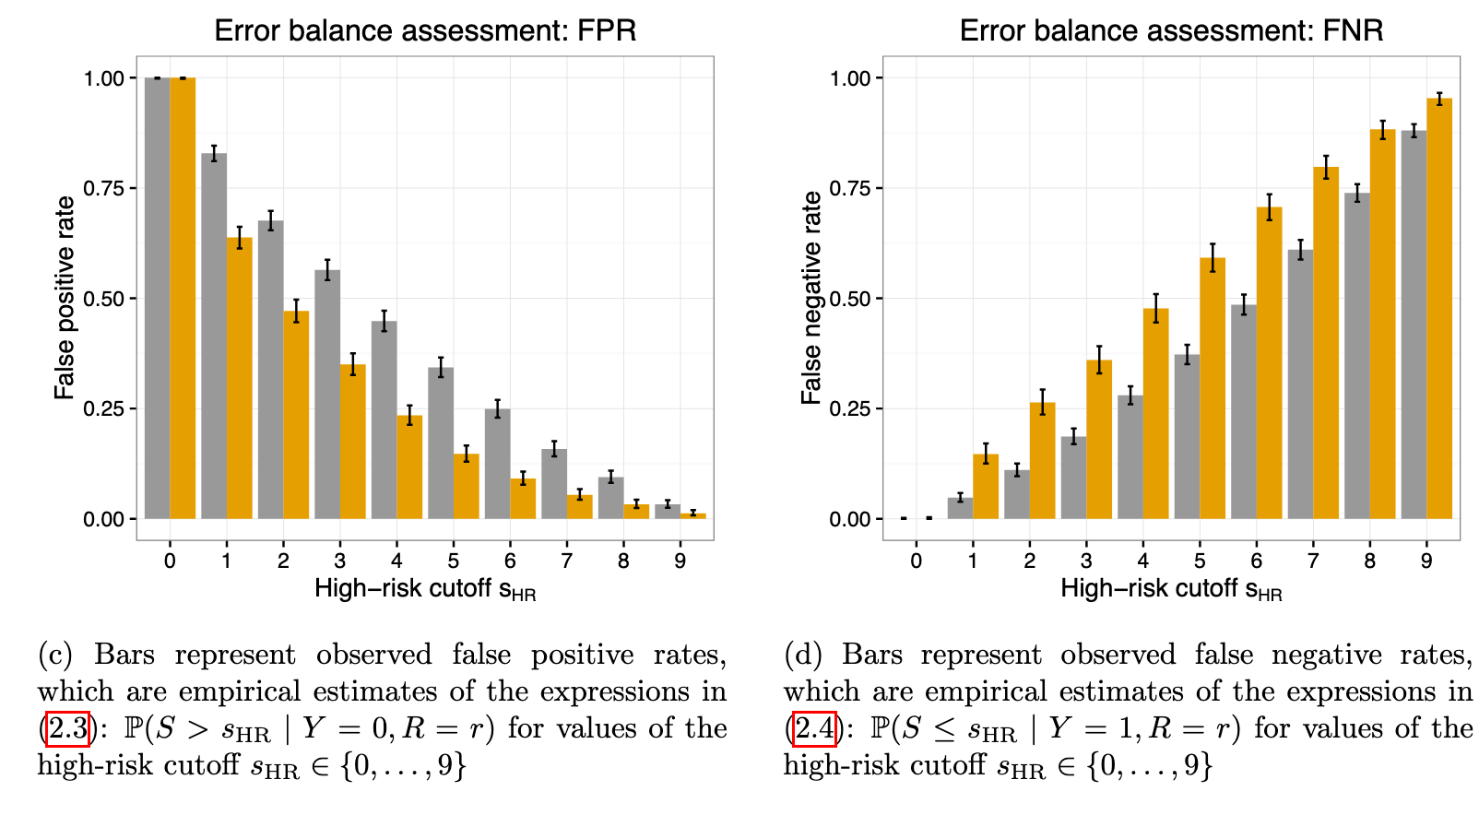

Slide 9
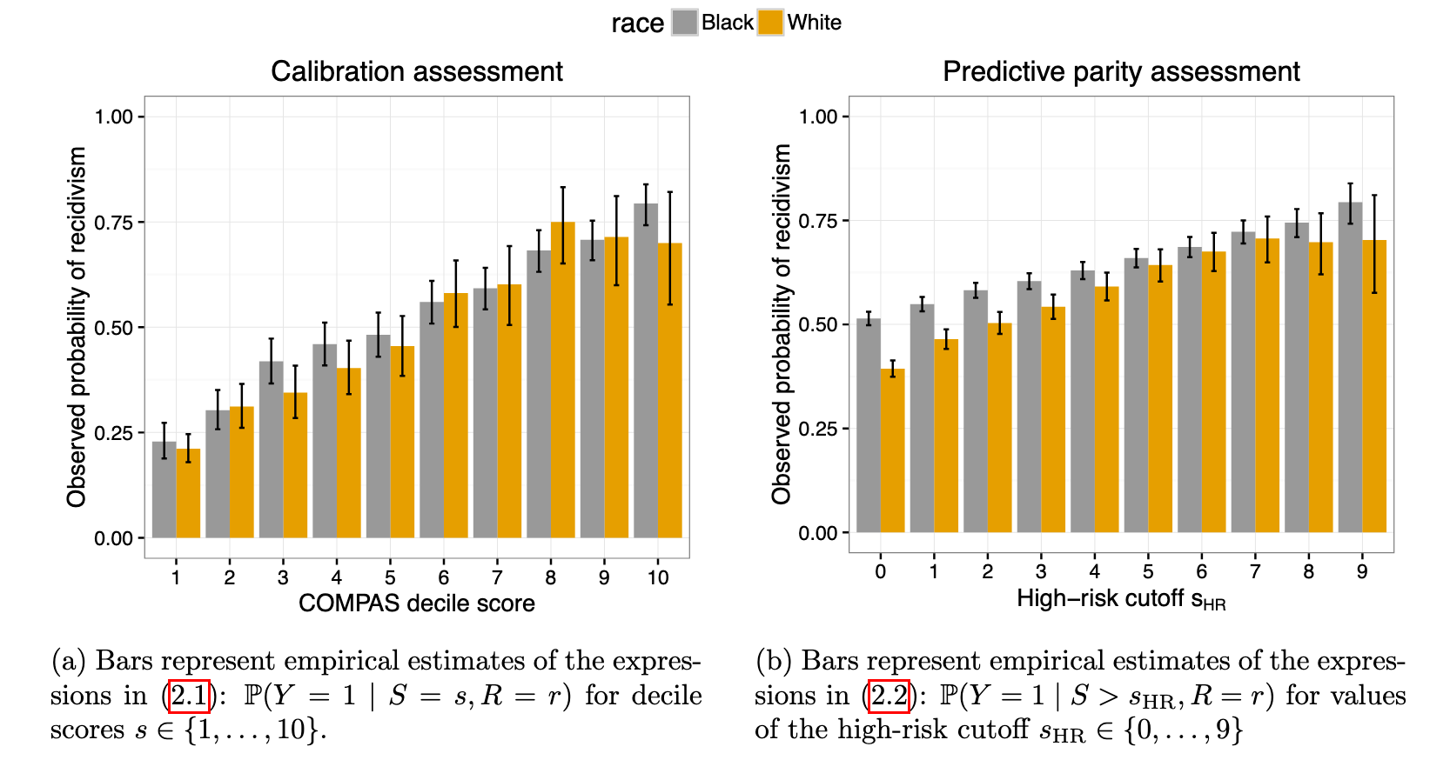
Chouldechova 2017. Fair prediction with disparate impact: A study of bias in recidivism prediction instruments

Slide 10
Automating High-Stakes Decisions
What credit score should be required to get a certain loan?
Which defendants should be freed until their trial?
Which candidates should get a certain job?
Which students should get into a university?

Slide 11
Characteristics of these decisions
Decisions try to predict the future
Will they repay the loan? Commit another crime? Succeed at the job?
Quantifiable measures used
Income, past arrests, …
Measures may not reflect reality
Arrests ≠ crimes, current income ≠ ability to pay
Measures may not reflect our values
Historical redlining -> lower current income
Incarceration weakens families, …
AI systems encode a policy

Slide 12
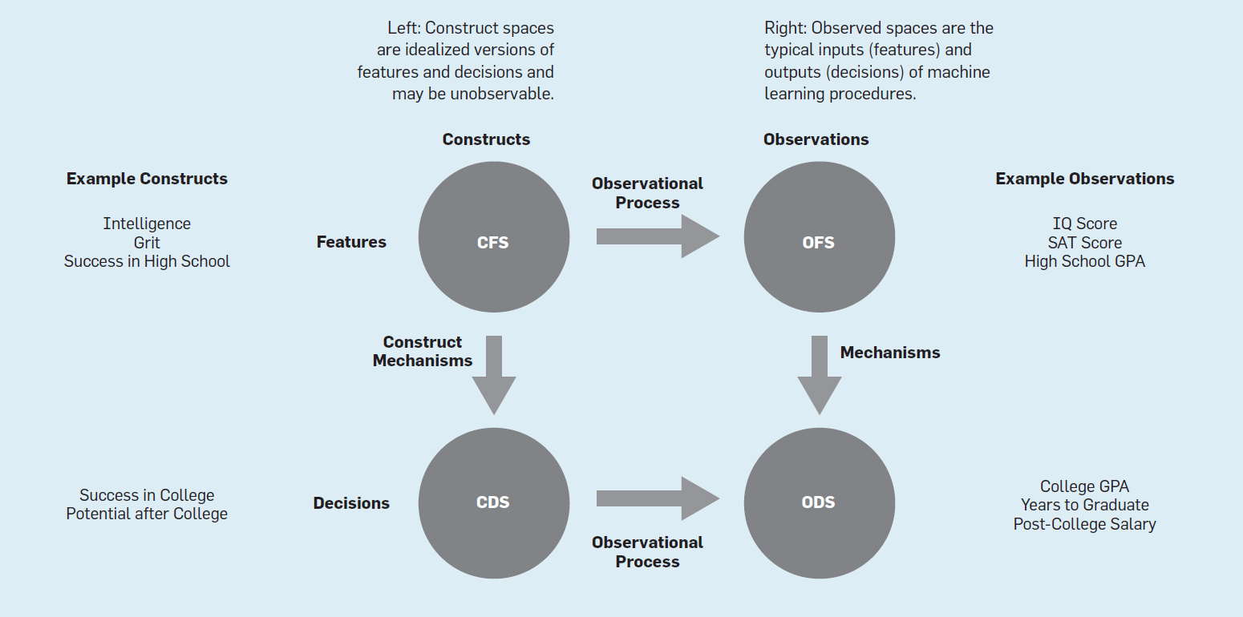
Friedler et al., 2021. The (Im)possibility of Fairness: Different Value Systems Require Different Mechanisms For Fair Decision Making

Slide 13
Goals
Individual fairness: similar people get similar decisions
Non-discrimination: similar groups get similar decisions
Algorithm (or policy) should aim to equalize, across groups:
Error rate
False positive rate
False negative rate
% classified positive
…

Slide 14
Impossibility of Fairness(?)
Pick no more than 2 of:
Predictive parity (if it says 40% will recidivate, about 40% recidivate)
Demographic parity (offer jobs to Black / White at same rate)
Equal false positive rates
Equal false negative rates
Equal accuracy
…
Chouldechova 2017. Fair prediction with disparate impact: A study of bias in recidivism prediction instruments; extended based on slides by Arvind Narayanan

Slide 15
Are there true differences between groups?
WYSIWYG
Individual fairness: “Treat similar individuals similarly”
Measures are good enough (even if groups differ)
WAE
Group fairness: “Equalize the outcomes between groups”
Each group has equal merit
so any differences in measures is a flaw to correct
Friedler et al., 2021. The (Im)possibility of Fairness: Different Value Systems Require Different Mechanisms For Fair Decision Making

Slide 16
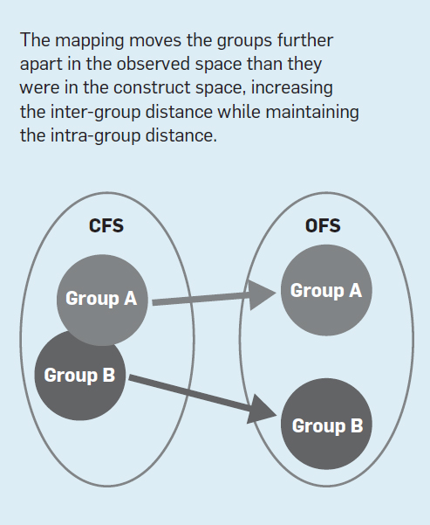
Group Skew

Slide 17
Worldview Analysis
What worldview did the MIT lecture implicitly espouse?

Slide 18
Tell my people their transgression and the house of Jacob their sins.
They seek me day after day and delight to know my ways,
like a nation that does what is right and does not abandon the justice of their God. They ask me for righteous judgments; they delight in the nearness of God.” …
Isn’t this the fast I choose: To break the chains of wickedness, to untie the ropes of the yoke, to set the oppressed free, and to tear off every yoke? Is it not to share your bread with the hungry, to bring the poor and homeless into your house, to clothe the naked when you see him, and not to ignore your own flesh and blood?
…
If you get rid of the yoke among you,
the finger-pointing and malicious speaking,
and if you offer yourself to the hungry, and satisfy the afflicted one,
then your light will shine in the darkness,
and your night will be like noonday.
Isaiah 58 (CSB)
What sorts of automated decision policies would satisfy Isaiah’s demands?
What fairness worldview is Isaiah using?

Slide 19
Are human lives predictable?
Hundreds of researchers attempted to predict six life outcomes, such as a child’s grade point average and whether a family would be evicted from their home. These researchers used machine-learning methods optimized for prediction, and they drew on a vast dataset that was painstakingly collected by social scientists over 15 y. However, no one made very accurate predictions. For policymakers considering using predictive models in settings such as criminal justice and child-protective services, these results raise a number of concerns. Additionally, researchers must reconcile the idea that they understand life trajectories with the fact that none of the predictions were very accurate.
Salganik et al. 2020. Measuring the predictability of life outcomes with a scientific mass collaboration

Slide 20
Review of Christian perspectives

Slide 21
God made a data-rich world
A rich environment for us to explore and learn
Our senses should lead us to worship
Romans 1
Psalm 19
Romans 10

Slide 22
God expects us to use our intelligence
Part of the image of God
We’re commanded to see, hear, remember, use our minds, …

Slide 23
But we have misused our intelligence
Selfish accumulation of data, power, …
Designing for engagement over thoughtfulness, love
Surveillance replaces relationships
Over-quantification
Exploitation
How do we treat those who can’t repay us?

Slide 24
Jesus redeems our technology
Serve others, hold organizations accountable, protect environment
Care about other people and cultures
How else?
Notes:
Ethical concerns, admitting our brokenness, need for redemption, recognize tech bias

Slide 25
Final Discussions

Slide 26
Personal Impacts
How AI has impacted my life in the past few years. For better? For worse?
How AI has impacted the lives of people unlike me.
How AI might impact our lives in the next 5 years.

Slide 27
Development
Something useful or cool that has recently become possible thanks to AI.
What are some things that AI systems are already better than humans at?
What are some things that humans are still much better at than AI systems?

Slide 28
Broader Impacts
Earth Day is tomorrow. Is AI good for the environment? Bad?
Is AI good for society? Bad?
Is AI good for human creativity? is it bad?

Slide 29
Christian Perspectives
Something that Christians should consider as people who consume AI-powered products?
…As people who use AI in their organizations?
…as people who develop AI?

